Slide 1
Psalms From Nature: The Greatness And Power Of God
Studying the Psalms
Psalms 8
April 30, 2023

Slide 2
The Greatness And Power Of God
God and Man – a series of contrasts. Man’s place in the universe (verses 3-8).
The heavens are small in contrast to God’s greatness – 8:3, 6; Isaiah 40:12, 26
“Of old didst thou lay the foundation of the earth; and the heavens are the work of thy hands.” (Psalms 102:25; Hebrews 1:10; Genesis 1:1; Psalms 33:6).
Man is small in contrast to the vast heavens – 8:3-4
By comparison, man is insubstantial and short –lived. (Isaiah 51:6-8; Psalms 144:3-4).

Slide 3
The Greatness And Power Of God
God and Man – a series of contrasts. Man’s place in the universe (verses 3-8).
Man is Small in Contrast to the vast heavens – 8:3-4
We marvel that God should pay even the slightest attention to us.
Yet, the Creator of the ends of the earth, who never wearies, and whose understanding has no limits (Isaiah 40:28), chooses to be mindful of such insignificant “grasshoppers” (Isaiah 40:22).
He was mindful of the helpless creatures in the ark endangered by the Flood (Genesis 8:1).
He was mindful of Hannah in her humiliation (1 Samuel 1:19).
The Lord visits the earth when He makes it bring forth and flourish (Psalms 65:9ff).
He was mindful of the Israelites when He delivered them from Egypt (Genesis 50:24) and from Babylon (Jeremiah 29:10)

Slide 4
The Greatness And Power Of God
God and Man – a series of contrasts. Man’s place in the universe (verses 3-8).
Man is small in contrast to His exalted position in the universe – 8:5-8
He visited all of us, both Jews and Gentiles, when He delivered us from our sins by means of His Son (Luke 1:68; Acts 15:14).
God cared enough to send Jesus to die for us John 3:16; Romans 5:8.
Peter summed it up saying, “He cares for you” 1 Peter 5:6-7.

Slide 5
The Greatness And Power Of God
God and Man – a series of contrasts. Man’s place in the UNIVERSE (verses 3-8).
A little lower than the angels, yet crowned with glory and honor – 8:5.
Note: When Jesus came to earth, He was a man – Hebrew 2:6-7
In this we know that He understands us – Hebrews 2:17-18; Philippians 2:5-8

Slide 6
The Greatness And Power Of God
Psalms 8:5, “For thou hast made him a little lower than the angels, and hast crowned him with glory and honour.” KJV
Psalms 8:5, “For thou hast made him but little lower than God, and crownest him with glory and honor.” ASV
Psalms 8:5, “Yet Thou hast made him a little lower than God, And dost crown him with glory and majesty!” NASV
NOTE: The Spirit of God accepted the Greek translation aggelous (angels) in Hebrews 2:7, and explicitly stated that this verse discusses the subject of angels (Hebrews 2:5, 9).

Slide 7

The Greatness And Power Of God
God and Man – a series of contrasts. Man’s place in the WORLD (verses 3-8).
Man has dominion over creation – 8:6; Genesis 2:15.
As stewards, we DO need to take care of the earth but understand that its resources are here FOR us – Genesis 1:26, 28; 9:2 (after the flood), “into your hand are they delivered.”

Slide 8
The Greatness And Power Of God
Man is a King in creation (verses 3-8).
Verse 5 – “Thou … crownest” Song of Solomon 3:11; Isaiah 23:8
Glory and Honor – Psalms 21:5
Verse 6 – “Thou makest him to have dominion over the works of thy hands”
You made him to rule – Judges 8:22-23
Verse 6 – “Thou hast put all things under his feet” Psalms 110:1

Slide 9
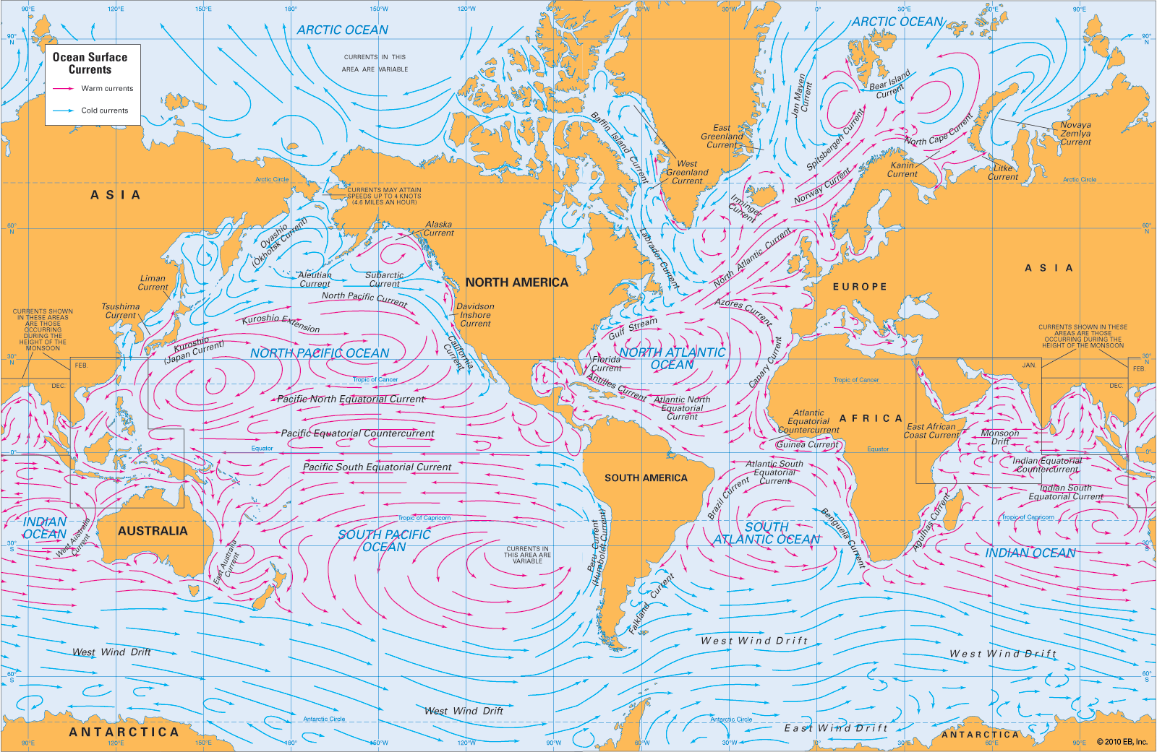
Paths Of The Seas - Psalms 8:8 (~1000 BC).
1855 AD: Matthew Fontaine Maury an American astronomer, historian, oceanographer, meteorologist, cartographer, author, geologist, educator, and naval officer, upon hearing Psalms 8:8 read to him by his son, set out to discover and chart the oceans’ sea lanes and currents. (Statue of Maury in Richmond, VA. Nicknamed “the Pathfinder of the Seas.”)

Slide 10
The Greatness And Power Of God
Jesus Is The Fulfillment of Psalms 8
Matthew 21:16 – Jesus applies verse 2 to events – Words applied to God spoken of Jesus – Psalms 102:25-27
Hebrews 2:6-9 applies verses 4-6 to Jesus.
Ephesians 1:22; 1 Corinthians 15:25-27 apply phrase verse 6 to Jesus.
Jesus is now set far above the angels (Hebrews 1:3-4; 1 Peter 3:22; Philippians 2:9-11; cf. Ephesians 1:21)

Slide 11
The Greatness And Power Of God
How excellent is Your Name.
David concludes (verse 9) repeating verse 1. “O Jehovah, our Lord, how excellent is thy name in all the earth!”
Remember this is a song that was sung in worship. Much like the chorus in our songs, many psalms had repetition.
Paul said that one day we will ALL bow before Him, the question is whether or not it will be too late when we do. Philippians 2:10-11

Slide 12
Next: Psalms of Repentance
Psalms 6, 32, 38, 51

